Slide 1

DEPARTMENT OF DATA SCIENCES AND ANALYTICS
HOUSE PRICE PREDICTION – A comparative approach
Guided by:
Mr. Suresh Kumar Choudhary
Assistant Professor
Presented by:
Mr. Bimal Kumar
Mr. Pradyumna Kumar Sahoo

Slide 2
1. Our first question : What ?
WE ARE PREDICTING HOUSE PRICES BASED ON THEIR FEATURES.
House data
Model
House prices

Slide 3
2. Second Question: Why?
Well because we will get marks for this ☺
We want unbiased estimations
We want accurate prices
We want automated results

Slide 4
3. Third Question : How?
Collection and Pre-processed the data
Data Analysis
ML algorithms applied

Slide 5
Collection and Pre-processed the data :
open-sourced dataset from KaggleInc
Removed unnecessary features
Filled up all NaN with mean of the respective features

Slide 6
Columns:
Id = a notation for a house
Date=Date house was sold
Bedrooms=Number of Bedrooms/House
Bathrooms=Number of bathrooms/House
sqft_living=square footage of the home
sqft_lot=square footage of the lot
Floors=Total floors (levels) in house
Waterfront=House which has a view to a waterfront
View=Has been viewed
Condition=How good the condition is ( Overall )
Grade=overall grade given to the housing unit, based on King County grading system
sqft_above=square footage of house apart from basement
sqft_basement=square footage of the basement
yr_built=Built Year
yr_renovated=Year when house was renovated
Zipcode=zip
Lat=Latitude coordinate
Long=Longitude coordinate
sqft_living15=Living room area in 2015(implies-- some renovations) This might or might not have affected the lotsize area
sqft_lot15=lotSize area in 2015(implies-- some renovations)

Slide 7
Exploratory Data analysis :
Preliminary summary
Univariate analysis
Bivariate Analysis
Correlation matrix
Removed highly correlated features
(to save ourselves from curse of dimensionality)

Slide 8
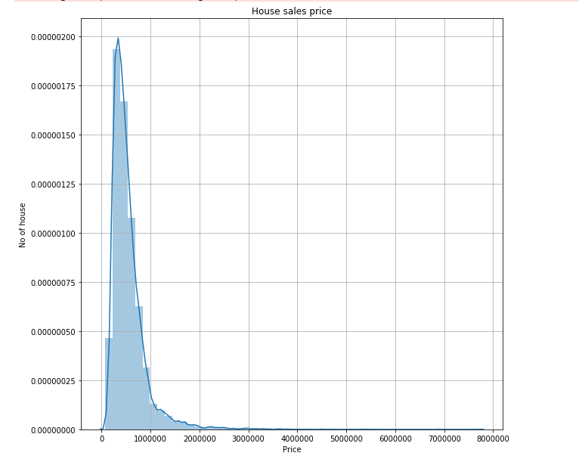
House-price graph:

Slide 9
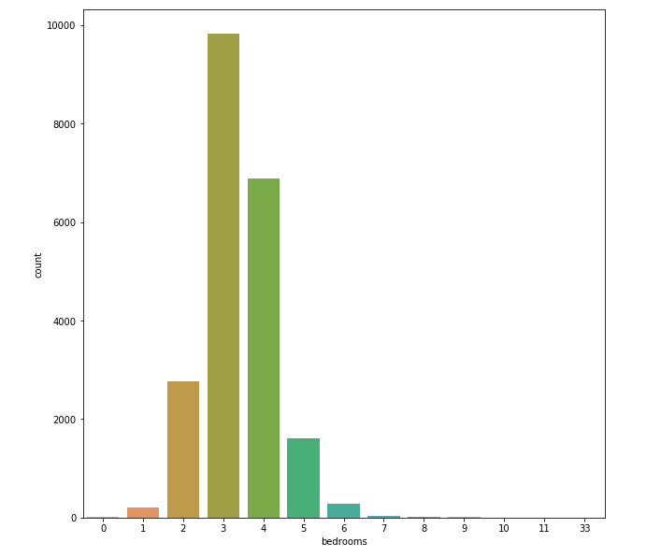
Bedrooms counts:

Slide 10
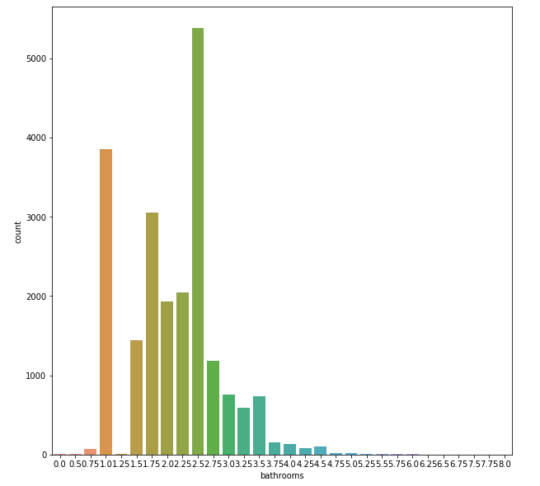
Bathroom counts:

Slide 11
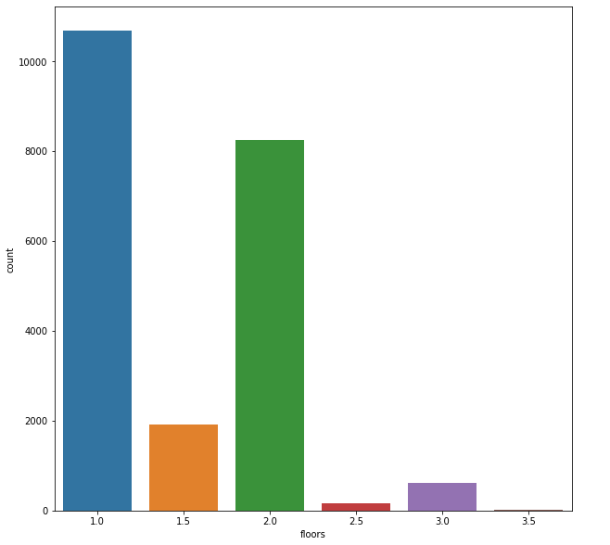
Floor counts :

Slide 12
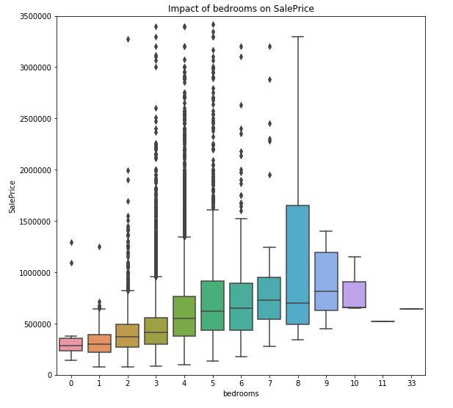

Slide 13
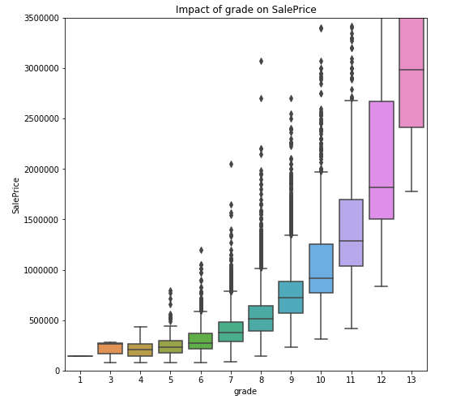

Slide 14
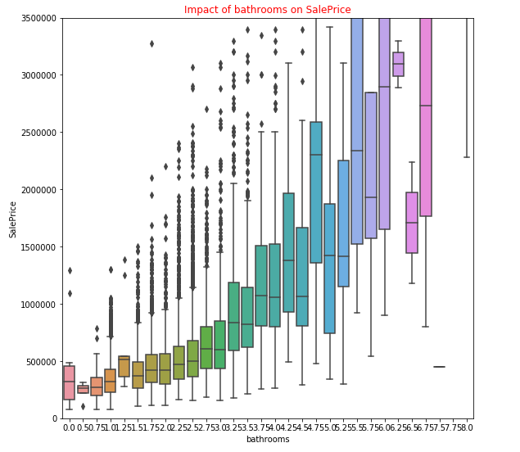

Slide 15
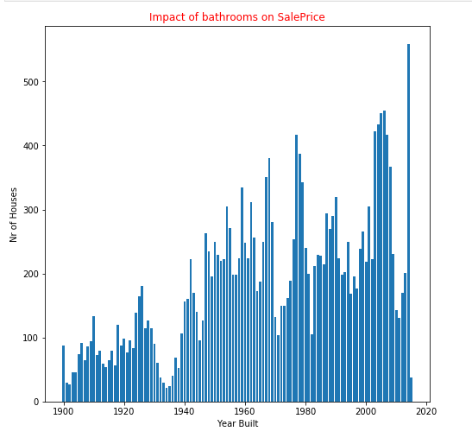

Slide 16
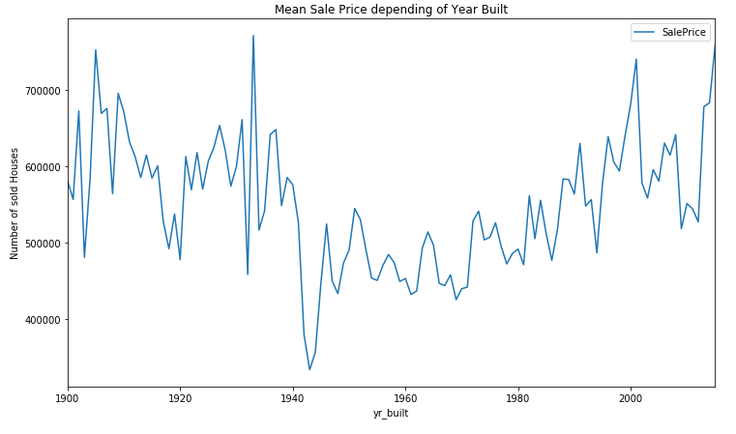

Slide 17
Machine algorithms applied
House price estimations
Linear regression
ElasticNet
Regression
Ridge regression
LASSO regression

Slide 18

4. Last question : Did it Work??

Slide 19
Evaluation:
ML ALGORITHMS | R2-SCORE
1.Simple Linear Regression | 70%
2.LASSO Regression | 69%
3.Ridge Regression | 70%
4.ElasticNet Regression | 69.81%
5. Polynomial regression (deg=2) | 72%

Slide 20
Resources used :
KAGGLE dataset
JUPYTER lab
Python packages : seaborn,numpy,pandas,matplotlib,sklearn
REFERENCE:
VALUATION OF HOUSE PRICES USING PREDICTIVE TECHNIQUES-International Journal of Advances in Electronics and Computer Science, ISSN: 2393-2835 - Volume-5, Issue-6, Jun.-2018

Slide 21

Thank you all ☺

